Slide 1
Design and Analysis of Algorithms (UE18CS251)
Unit II - Brute Force
Mr. Channa Bankapur
channabankapur@pes.edu

Slide 2
Brute Force:
A straightforward approach, usually directly based on the problem statement and definitions of the concepts involved.
Examples:
Sequentially searching for a key of a given value in a list
Computing n! by finding the product of 1 thru n.
Computing a^{n} (a > 0, n ≥ 0) by multiplying ‘a’ n times.
Hacking a password by matching all possible passwords.
“Force” by the computer in terms of effort, but simple in strategy to implement.
Trial and Error method of trying out in some order.
Exhaustive effort rather than employing intellectual strategies.
Often one of the easiest way to solve it.

Slide 3
Algorithm SequentialSearch(A[0..n-1], K)
//Outputs the index of the first element of A that
// matches K or -1 if there are no matching elements.
i ← 0
while (i < n) and (A[i] ≠ K) do
i ← i + 1
if (i < n) return i
return -1
Input size: n.
Basic Operation: (i < n) and (A[i] ≠ K)
C_{worst}(n) = n+1
C_{best}(n) = 1
Let ‘p’ be the probability of the search key present in the array.
C_{avg}(n) = p(n + 1) / 2 + (1 - p)(n + 1)

Slide 4
Algorithm SequentialSearch(A[0..n-1], K)
Input Size: n
Basic Operation : (i < n) and (A[i] ≠ K)
C_{worst}(n) = Count of the basic operation at the max
= n + 1 ∈ 𝚹(n)
C_{best}(n) = 1 ∈ 𝚹(1)
C_{avg}(n) = from (n+1)/2 to (n+1) depending on the probability of search key being present in the input array.
C_{avg}(n) ∈ 𝚹(n)

Slide 5

Brute-Force String Matching:
In an n-characters text, search for the first occurrence of m-character pattern.
There are n-m+1 substrings of length m in the text of length n. Find the first such substring which matches with the pattern.
Find i, the index of the leftmost character of the first matching substring in the text such that

Slide 6
NaiveStringMatch(T[0..n-1], P[0..m-1])
for i ← 0 to n-m
j ← 0
while (j < m and T[i+j] = P[j])
j ← j + 1
if(j = m) return i
return -1
Analysis:
Input Size: n, m
Basic Operation : (T[i+j] = P[j])
…

Slide 7
Input Size: n, m
Basic Operation : (T[i+j] = P[j])
C_{best}(n) = 0, when n < m
= min(m, n-m+1) when n ≥ m
= 1 when n = m
= m, when n ≥ 2m-1 (i.e., n-m+1 is at least m)
= max(0, min(m, n-m+1)), for any n, m
C_{best}(n) ∈ Θ(m) with n ≥ 2m-1
C_{best}(n) ∈ O(m) for any n, m
C_{worst}(n) = (n - m + 1) * m ∈ Θ(nm)
C_{avg}(n) ∈ O(nm)

Slide 8
A brute force way of sorting:
Find an arrangement of elements of an array, which is sorted.
Strategy: For every possible arrangements of an array, check if it’s sorted, and return the arrangement which is sorted.
boolean SortByExhaustiveSearch( A[0..n-1] )
//Sorts array A by trying out all possible arrangements of elements of the array.
//Input: An array A of orderable elements by ≤.
//Output: Sorted array A by ≤.
for each permutation p[0..n-1] of array A
if (isSorted( p[0..n-1] ))
return p[0..n-1]

Slide 9
Write an algorithm to check if the array is sorted.
boolean isSorted( A[0..n-1] )
//Checks if the array A is sorted.
//Input: An array A of orderable elements by ≤.
//Output: Return TRUE if array is sorted.
// FALSE otherwise.
...

Slide 10
Write an algorithm to check if the array is sorted.
boolean isSorted( A[0..n-1] )
//Checks if the array A is sorted.
//Input: An array A of orderable elements by ≤.
//Output: Return TRUE if array is sorted.
// FALSE otherwise.
for i ← 0 to n-2
if(A[i] > A[i+1]) //not in order
return FALSE
return TRUE

Slide 11
Sort by fixing the problems while checking for sortedness.
SortByCheckingSortedness( A[0..n-1] )
//Sorts by Checking sortedness.
//Input: An array A of orderable elements by ≤.
//Output: Sorted array A.
for i ← 0 to n-2
if(A[i] > A[i+1])
Swap A[i] with A[i+1]
Does it sort?

Slide 12
Sort by fixing the problems while checking for sortedness.
SortByCheckingSortedness2( A[0..n-1] )
//Sorts by Checking sortedness.
//Input: An array A of orderable elements by ≤.
//Output: Sorted array A.
while (TRUE)
for i ← 0 to n-2
if(A[i] > A[i+1])
Swap A[i] with A[i+1]
if(isSorted( A[0..n-1] ))
return
Does it sort and that too in a finite amount of time?

Slide 13
Sort by fixing the problems while checking for sortedness.
SortByCheckingSortedness3( A[0..n-1] )
//Sorts by Checking sortedness.
//Input: An array A of orderable elements by ≤.
//Output: Sorted array A.
for i ← 0 to n-2 //n-1 consecutive pairs
if(A[i] > A[i+1])
Swap A[i] with A[i+1]
if(isSorted( A[0..n-1] ))
return
SortByCheckingSortedness3(A[0..n-2])
It should sort.
Can we move isSorted() logic into the for loop?

Slide 14
Algorithm SortByCheckingSortedness4(A[0..n-1])
//Sorts by an improved Bubble Sort algorithm.
//Input: An array A of orderable elements by ≤.
//Output: Sorted array A.
isSorted ← TRUE
for i ← 0 to n-2
if(A[i] > A[i+1])
Swap A[i] with A[i+1]
isSorted ← FALSE
if(isSorted = TRUE)
return
SortByCheckingSortedness4(A[0..n-2])
Base case for the recursion?

Slide 15
Algorithm SortByCheckingSortedness5(A[0..n-1])
//Sorts by an improved Bubble Sort algorithm.
//Input: An array A of orderable elements by ≤.
//Output: Sorted array A.
if(n <= 1) return
isSorted ← TRUE
for i ← 0 to n-2
if(A[i] > A[i+1])
Swap A[i] with A[i+1]
isSorted ← FALSE
if(isSorted = TRUE)
return
SortByCheckingSortedness5(A[0..n-2])
Can we convert the recursive algorithm to iterative?

Slide 16
SortByCheckingSortedness6( A[0..n-1] )
//Sorts by Checking sortedness.
//Input: An array A of orderable elements by ≤.
//Output: Sorted array A.
m ← n
while(m>1)
isSorted ← TRUE
for i ← 0 to m-2 //m-1 consecutive pairs
if(A[i] > A[i+1])
Swap A[i] with A[i+1]
isSorted ← FALSE
if(isSorted = TRUE) return
m--
return

Slide 17
Algorithm BubbleSort( A[0..n-1] )
//Sorts by an improved Bubble Sort algorithm.
//Input: An array A of orderable elements by ≤.
//Output: Sorted array A.
for i ← n downto 2 //n-1 passes
isSorted ← TRUE
for j ← 0 to i-1 //last n-i elements are sorted
if(A[j] > A[j+1])
Swap A[j] with A[j+1]
isSorted ← FALSE
if(isSorted = TRUE)
return
return

Slide 18

Algorithm BubbleSort( A[0..n-1] )
//Sorts by Bubble Sort algorithm.
//Input: An array A of orderable elements by ≤.
//Output: Sorted array A.
for i ← n downto 2 //n-1 passes
for j ← 0 to i-1 //last n-i elements are sorted
if(A[j] > A[j+1])
Swap A[j] with A[j+1]
return

Slide 19
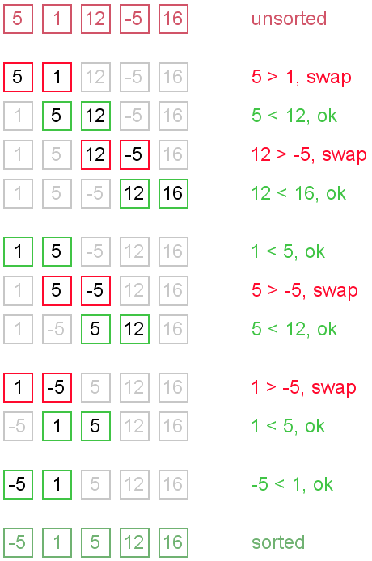

Slide 20
Analysis of Bubble Sort:
Algorithm BubbleSort( A[0..n-1] )
//Sorts by Bubble Sort algorithm.
//Input: An array A of orderable elements by ≤.
//Output: Sorted array A.
for i ← 0 to n-2 //n-1 passes
for j ← 0 to n-2-i //last i elements are sorted
if(A[j] > A[j+1])
Swap A[j] with A[j+1]
return

Slide 21
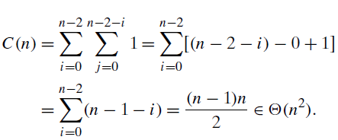
Algorithm BubbleSort( A[0..n-1] )
Input Size: n
Basic Operation: (A[j] > a[j+1])
C_{worst}(n) = n * (n - 1) / 2 ∈ Θ(n²)
C_{best}(n) = n * (n - 1) / 2 ∈ Θ(n²)

Slide 22
Bubble Sort (improved version):
Algorithm BubbleSortImproved( A[0..n-1] )
//Sorts by an improved Bubble Sort algorithm.
//Input: An array A of orderable elements by ≤.
//Output: Sorted array A.
for i ← 0 to n-2 //n-1 passes
anySwaps ← FALSE
for j ← 0 to n-2-i //last i elements are sorted
if(A[j] > A[j+1])
Swap A[j] with A[j+1]
anySwaps ← TRUE
if(anySwaps = FALSE)
return
return

Slide 23
Algorithm BubbleSortImproved( A[0..n-1] )
Input Size: n
Basic Operation : (a[i] > a[i+1])
C_{worst}(n) = n * (n - 1) / 2 ∈ Θ(n²)
C_{best}(n) = (n - 1) ∈ Θ(n)
C_{avg}(n) ∈ Θ(?)
Basic Operation : Swap
C_{worst}(n) = n * (n - 1) / 2 ∈ Θ(n²)
C_{best}(n) = 0 ∈ Θ(1)

Slide 24
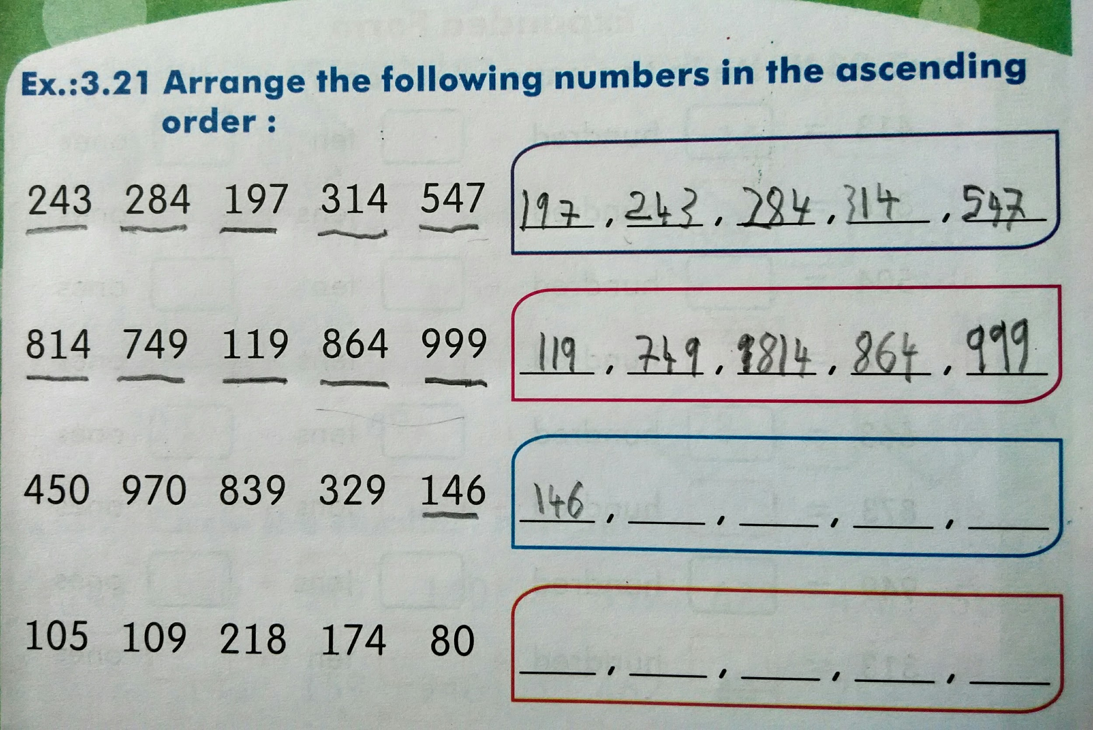
Yet another way of sorting by brute-force.

Slide 25
Selection Sort:
Find the smallest of the unsorted array and place it at the beginning of the unsorted array. Reduce the unsorted array by excluding the first one, which is already in its final position. Repeat sorting the unsorted array as long as there is only one element left in the unsorted array.
Algorithm SelectionSort_Recursive(A[0..n-1])
//Sorts a given array by Selection Sort.
//Input: An array A[0..n-1] of orderable elements.
//Output: Array A[0..n-1] sorted in ascending order.
if(n ≤ 1) return
min ← minIndex(A[0..n-1])
Swap A[0] with A[min]
SelectionSort_Recursive(A[1..n-1])

Slide 26

Selection Sort:
Find the smallest of the unsorted array and place it at the beginning of the unsorted array. Reduce the unsorted array by excluding the first one, which is already in its final position.
Algorithm SelectionSort(A[0..n-1])
//Sorts a given array by Selection Sort.
//Input: An array A[0..n-1] of orderable elements.
//Output: Array A[0..n-1] sorted in ascending order.
for i ← 0 to n-2
min ← minIndex(A[0..n-1])
Swap A[i] with A[min]

Slide 27
Algorithm SelectionSort(A[0..n-1])
//Sorts a given array by Selection Sort.
//Input: An array A[0..n-1] of orderable elements.
//Output: Array A[0..n-1] sorted in ascending order.
for i ← 0 to n-2
min ← i
for j ← i+1 to n-1
if(A[j] < A[min]) min ← j
Swap A[i] with A[min]
return A

Slide 28
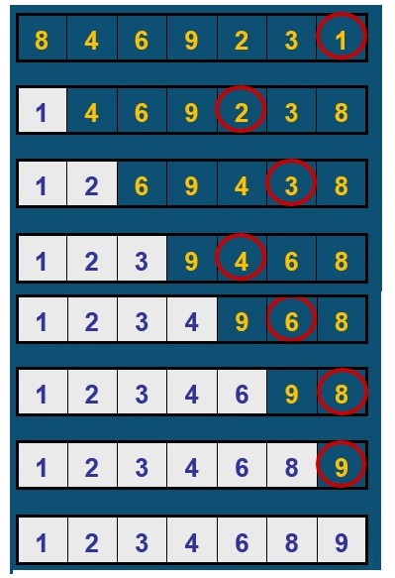
Selection Sort:
Example: 8 4 6 9 2 3 1

Slide 29
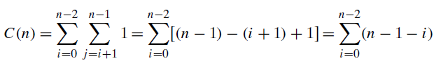

Analysis of Selection Sort:
Input Size: n (size of the list)
Basic Operation: Comparison (A[j] < A[min])
C_{best}(n) = C_{worst}(n) = C_{avg}(n)

Slide 30
Polynomial Evaluation:
p(x)= a_{n}x^{n} + a_{n-1}x^{n-1} +… + a₁x¹ + a₀ at x=x₀
Algorithm Polynomial(n, x₀, a[0..n])
//Output: Value of the polynomial at x = x₀.
...

Slide 31
Polynomial Evaluation:
p(x)= a_{n}x^{n} + a_{n-1}x^{n-1} +… + a₁x¹ + a₀ at x=x₀
Algorithm Polynomial(n, x₀, a[0..n])
//Output: Value of the polynomial at x = x₀.
p ← 0.0
for i ← n downto 0 do
power ← 1
for j ← 1 to i do //compute x^{i}
power ← power * x₀
p ← p + a_{i} * power
return p
Input Size:
Basic Operation :
C(n) =

Slide 32
Polynomial Evaluation:
p(x)= a_{n}x^{n} + a_{n-1}x^{n-1} +… + a₁x¹ + a₀ at x=x₀
Algorithm Polynomial(n, x₀, a[0..n])
//Output: Value of the polynomial at x = x₀.
p ← 0.0
for i ← n downto 0 do
power ← 1
for j ← 1 to i do //compute x^{i}
power ← power * x₀
p ← p + a_{i} * power
return p
Input Size: n
Basic Operation : power ← power * x₀
C(n) = n * (n + 1) / 2 ∈ Θ(n²)

Slide 33
p ← 0.0
for i ← n downto 0 do
power ← 1
for j ← 1 to i do //compute x^{i}
power ← power * x
p ← p + a[i] * power
return p
--------------------------------
p ← a[0]
power ← 1
for i ← 1 to n do
power ← power * x
p ← p + a[i] * power
return p

Slide 34
Polynomial Evaluation:
p(x)= a_{n}x^{n} + a_{n-1}x^{n-1} +… + a₁x¹ + a₀ at x=x₀
Algorithm Polynomial2(n, x₀, a[0..n])
//Output: Value of the polynomial at x = x₀.
p ← a₀
power ← 1
for i ← 1 to n do
power ← power * x //compute x^{i}
p ← p + a_{i} * power
return p
Input Size: n
Basic Operation : power ← power * x₀
C(n) = n ∈ Θ(n)

Slide 35
Exhaustive Search:
A brute force solution to a problem involving search for an element with a special property, usually among combinatorial objects such as permutations, combinations, or subsets of a set.
Method:
Generate a list of all potential solutions to the problem in a systematic manner.
Evaluate potential solutions one by one, disqualifying infeasible ones and, for an optimization problem, keeping track of the best one found so far.
When search ends, announce the solution(s) found.

Slide 36
Travelling Salesman Problem:
Given n cities and distances between each pair of cities, find the shortest tour that passes through all other cities and returns to the origin city.
In case of a weighted complete graph, it’s about finding the shortest Hamiltonian circuit.
Eg: Driving time between some 10 cities of India (Cost Matrix).
000000 110189 050573 020948 109480 034435 028433 074836 091767 068406
109006 000000 079663 118195 079397 143304 083593 045792 037923 068146
051516 080265 000000 070149 121881 083636 044745 043763 042416 067450
021557 119539 069838 000000 095820 042397 037471 084186 111032 077756
110053 081231 121373 095977 000000 134475 085826 087690 100264 054016
034488 144238 082769 041728 134042 000000 062482 108885 123963 102455
028473 084770 045153 037117 085732 062772 000000 049417 078006 042987
075056 046162 044536 084245 086579 109354 049641 000000 031151 038399
092933 037994 042414 111566 099497 125053 078960 031010 000000 068113
068718 068844 068336 077907 055357 103016 043305 038648 068634 000000

Slide 37
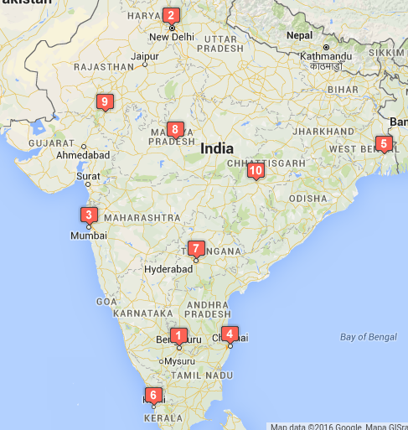
Travelling Salesman Problem:
Bengaluru
New Delhi
Mumbai
Chennai
Kolkata
Kochi
Hyderabad
Bhopal
Udaipur
Raipur

Slide 38
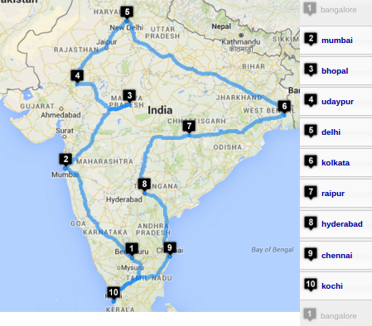
Travelling Salesman Problem:
Bengaluru
Mumbai
Bhopal
Udaipur
New Delhi
Kolkata
Raipur
Hyderabad
Chennai
Kochi
Bengaluru
Shortest round
trip takes
454201 sec.

Slide 39
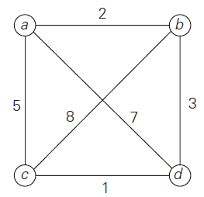
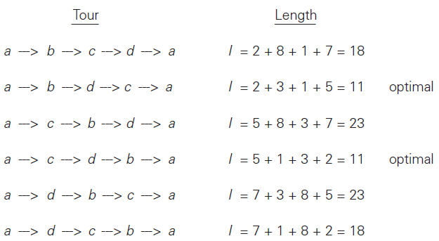
Travelling Salesman Problem:

Slide 40
Algorithm Travelling Salesperson Problem
mincost ← Infinity
for each permutation of (n - 1) cities
cost ← 0
for each edge in the Hamiltonian circuit
cost ← cost + cost of the edge
if (cost < mincost)
mincost ← cost
return mincost
Input Size: n
Basic Operation : addition of cost of an edge
C(n) = n * (n - 1)! = n! ∈ Θ(n!)

Slide 41
ALGORITHM TravellingSalesmanProblem
//Input: n x n adjacency matrix A. Assumed n > 1.
//Output: Min Cost Hamiltonian circuit.
//getPermutation(P[]) returns true with next permutation in lexicographic
// order, if it exists. Returns false otherwise.
mincost ← INFINITY
Permutation[1..n-1] ← [1, 2, 3, …, n-1] //1st permn.
do
cost ← A[0, Permutation[1]] //1st edge of the circuit
for i ← 1 to n-2
cost ← cost + A[Permutation[i], Permutation[i+1]]
cost ← cost + A[Permutation[n-1], 0] //last edge
if (cost < mincost) mincost ← cost
while(getNextPermutation(Permutation[1..n-1]))
return mincost

Slide 42
Sorting by exhaustive search:
Find an arrangement of elements of an array, which is sorted.
Strategy: For every possible arrangements of an array, check if it’s sorted, and return the arrangement which is sorted.
boolean SortByBruteForce( a[0..n-1] )
//Sorts array a by trying out all possible arrangements of elements of the array.
//Input: An array a of orderable elements by ≤.
//Output: Sorted array a by ≤.
for each permutation p[0..n-1] of array a
if (isSorted( p[0..n-1] ))
return p[0..n-1]

Slide 43
The Assignment Problem:
Each one of n people are assigned one of n jobs, exactly one person per job. The cost of assigning person i to job j is C[i, j]. Find an assignment that minimizes the total cost.
Job 0 Job 1 Job 2 Job 3
┌ ┐
P0 │ 9 2 7 8 │
P1 │ 6 4 3 7 │
P2 │ 5 8 1 8 │
P3 │ 7 6 9 4 │
└ ┘
Exhaustive Search Strategy:

Slide 44
The Assignment Problem:
Each one of n people are assigned one of n jobs, exactly one person per job. The cost of assigning person i to job j is C[i, j]. Find an assignment that minimizes the total cost.
Job 0 Job 1 Job 2 Job 3
┌ ┐
P0 │ 9 2 7 8 │
P1 │ 6 4 3 7 │
P2 │ 5 8 1 8 │
P3 │ 7 6 9 4 │
└ ┘
Strategy:
Generate all legitimate assignments,
Compute cost of each assignment, and
Select the cheapest one.

Slide 45
Cost Matrix Job 0 Job 1 Job 2 Job 3
┌ ┐
P0 │ 9 2 7 8 │
P1 │ 6 4 3 7 │
P2 │ 5 8 1 8 │
P3 │ 7 6 9 4 │
└ ┘
Assignment (col.#s) Total Cost
1, 2, 3, 4 9+4+1+4 = 18
1, 2, 4, 3 9+4+8+9 = 30
1, 3, 2, 4 9+3+8+4 = 24
1, 3, 4, 2 9+3+8+6 = 26
1, 4, 2, 3 9+7+8+9 = 33
1, 4, 3, 2 9+7+1+6 = 23
2, 1, 3, 4 2+6+1+4 = 13 etc.

Slide 46
Algorithm AssignmentProblem(C[0..n-1, 0..n-1])
//Input: n x n cost matrix C.
//Output: Cost of the cheapest assignment.
mincost ← Infinity
for each permutation of n jobs
cost ← 0, person ← 0
for each job in the assignment
cost ← cost + C[person, job]
person ← person + 1
if (cost < mincost) mincost = cost
return mincost
Input Size: n, Basic Operation : cost + C[person, job]
C(n) = n * n! ∈ Θ(n*n!)

Slide 47
Algorithm AssignmentProblem(C[0..n-1, 0..n-1])
//Input: n x n cost matrix C.
//Output: Cost of the cheapest assignment.
mincost ← Infinity
Permn[0..n-1] ← [0,1,2,…,n-1] //1st permn.
do
cost ← 0
for i ← 0 to n-1
cost ← cost + C[i, Permn[i]]
if (cost < mincost) mincost = cost
while(getNextPermn(Permn[0..n-1]))
return mincost
Input Size: n, Basic Operation : cost + C[i,Permn[i]]
C(n) = n * n! ∈ Θ(n*n!)

Slide 48
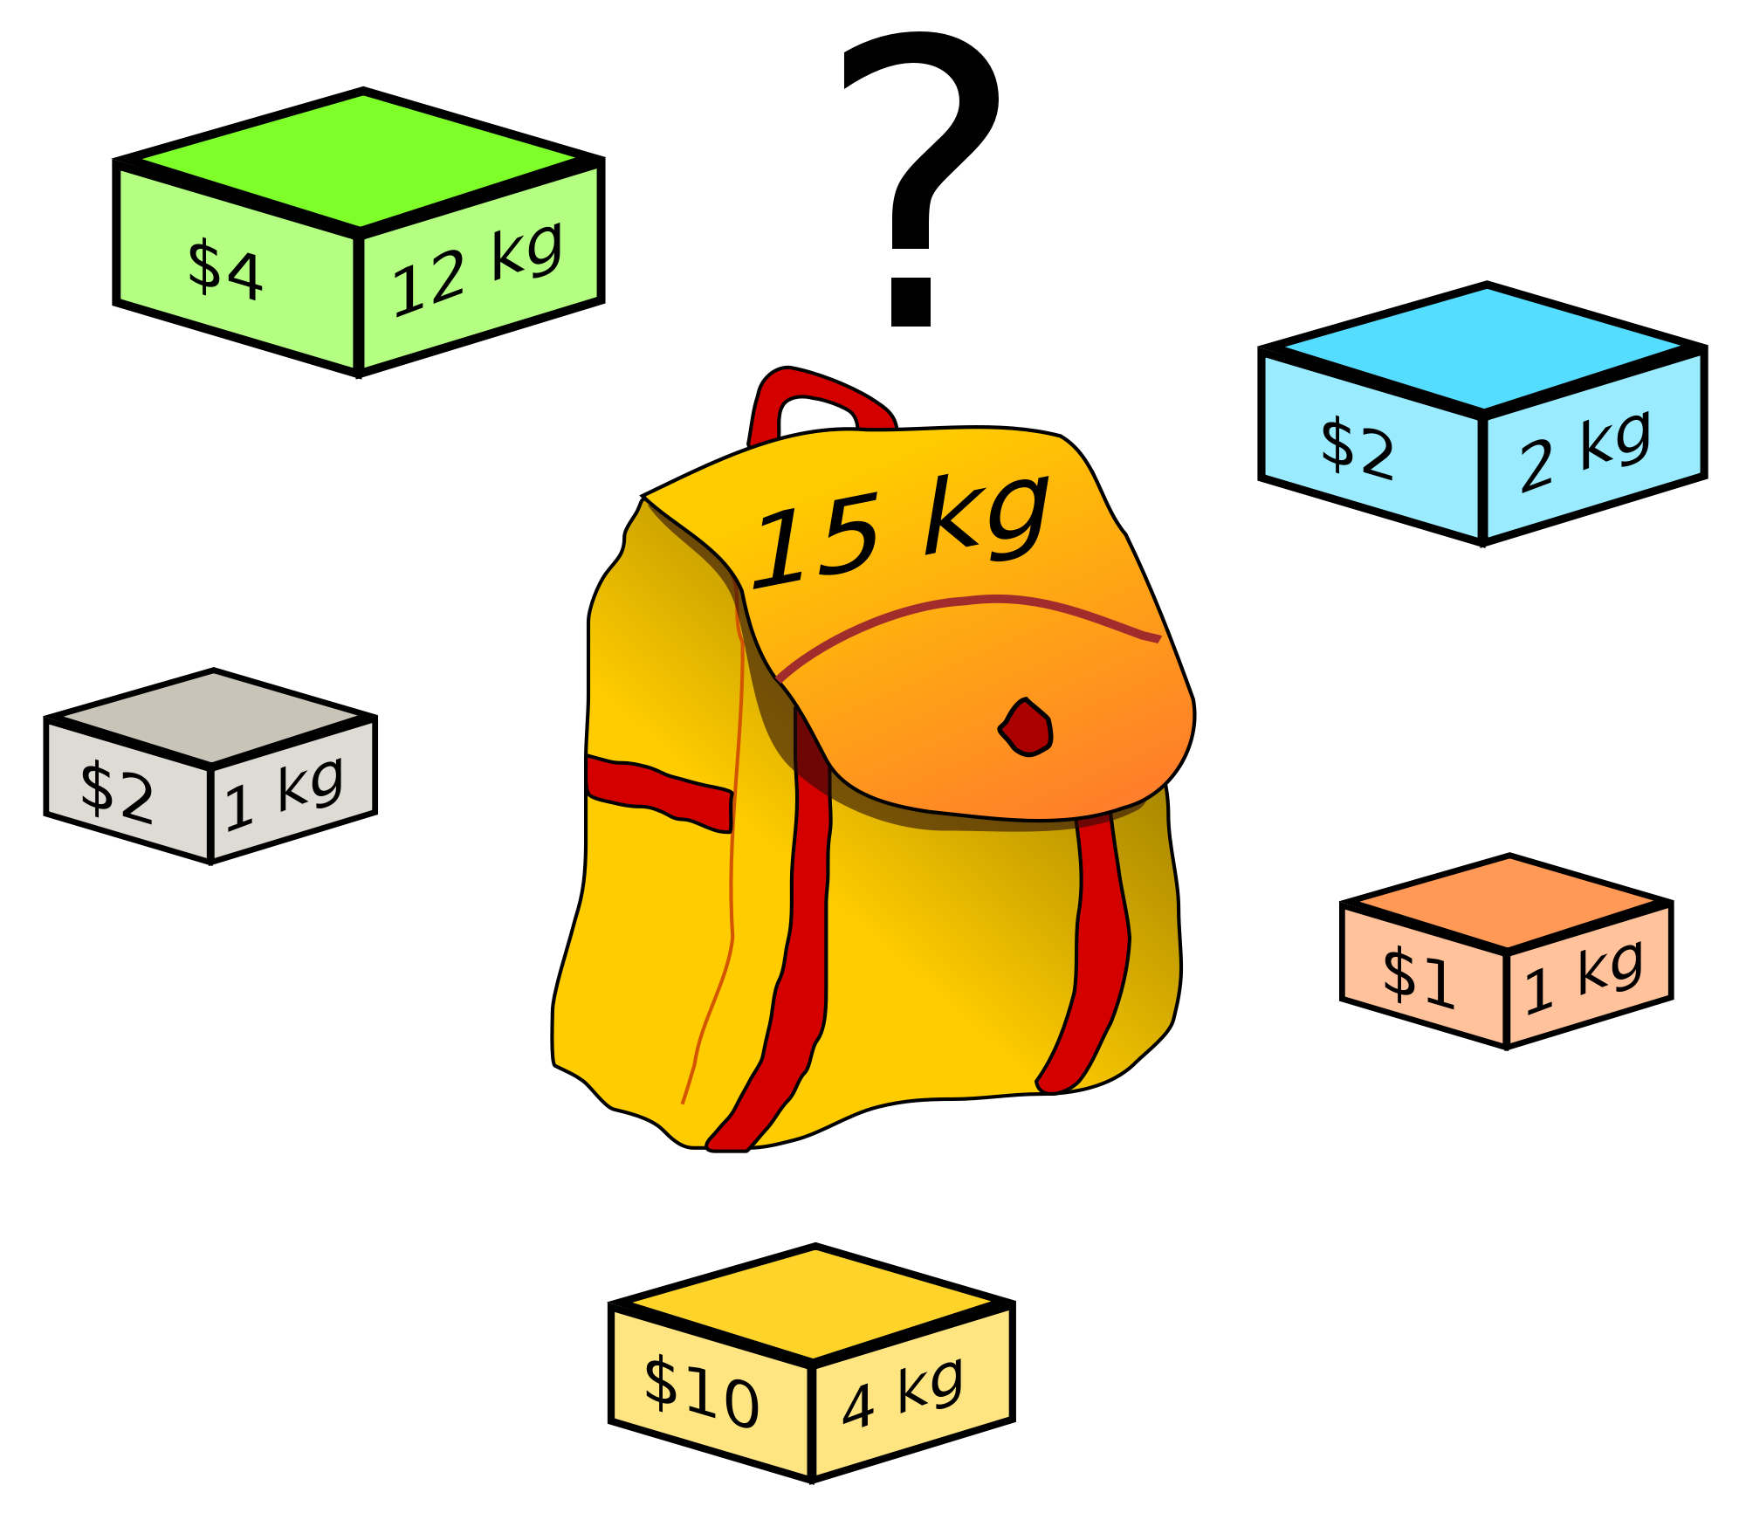
Knapsack Problem:
Given n items:
weights: w₁ w₂ … w_{n}
values: v₁ v₂ … v_{n}
a knapsack of capacity W
Find most valuable subset of the items that fit into the knapsack.

Slide 49
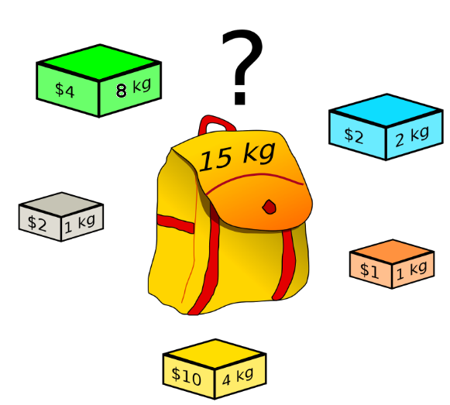
Knapsack Problem:
Given n items:
weights: w₁ w₂ … w_{n}
values: v₁ v₂ … v_{n}
a knapsack of capacity W
Find most valuable subset
of the items that fit into the knapsack.
Ans: {B,O,Y,W} 8kg, $15
What if the green object weighs 8 kg instead of 12 kg?

Slide 50
Knapsack Problem:
What if the green object weighs 8 kg instead of 12 kg?
Ans:
{G,B,Y,W}
15kg, $18

Slide 51
Example:
Knapsack capacity W=16
item weight value
1 2 $20
2 5 $30
3 10 $50
4 5 $10
{2,3} with value $80 is optimal.
C(n) ∈ 𝛀(2^{n})
Subset Total weight Total value
{} 0 $0
{1} 2 $20
{2} 5 $30
{3} 10 $50
{4} 5 $10
{1,2} 7 $50
{1,3} 12 $70
{1,4} 7 $30
{2,3} 15 $80
{2,4} 10 $40
{3,4} 15 $60
{1,2,3} 17 -
{1,2,4} 12 $60
{1,3,4} 17 -
{2,3,4} 20 -
{1,2,3,4} 22 -

Slide 52
Write a brute-force algorithm to find an optimal solution for the 0/1 Knapsack Problem.
Given n items:
weights: w₁ w₂ … w_{n}
values: v₁ v₂ … v_{n}
a knapsack of capacity W
Find most valuable subset
of the items that fit into the knapsack.

Slide 53
Multiplication of Large Integers:
Consider the problem of multiplying two (large) n-digit integers represented by arrays of their digits such as:
A = 12345678901357986429 B = 87654321284820912836
Brute-Force Strategy:
a₁ a₂ … a_{n}* b₁ b₂ … b_{n}
d₁₀d₁₁d₁₂ … d_{1n}
d₂₀ d₂₁d₂₂ … d_{2n}
… … … … … … …
d_{n0}d_{n1}d_{n2} … d_{nn}
2135 * 4014
8540
2135+
0000++
8540+++
_________________________________________________
8569890

Slide 54
Write a brute-force algorithm to multiply two arbitrarily large (of n digits) integers.
12345678 * 32165487
86419746
98765424+
49382712++
61728390+++
74074068++++
12345678+++++
24691356++++++
37037034+++++++
_______________________________________________________________
397104745215186
Basic Operation:
single-digit multiplication
C(n) = n² one-digit multiplications
C(n) ∈ Θ(n²)

Slide 55
May the Force be with you!
</ Brute Force >

